Slide 1

Serverless Deep Neural Network(DNN) with Azure Functions and ML.Net
Praveen Raghuvanshi
@praveenraghuvan

Slide 2


Introduction
Cloud Architect @ Harman, A Samsung Company
Domain: Professional Audio, Video & Control
Area of Expertise: Cloud, Distributed computing
Area of Interest: AI/ML and IoT
Location: Bangalore, India
Member:

Slide 3
Agenda
Serverless
Azure Functions
Deep Neural Networks(DNN)
Image Classification
ML.Net
Demo

Slide 4
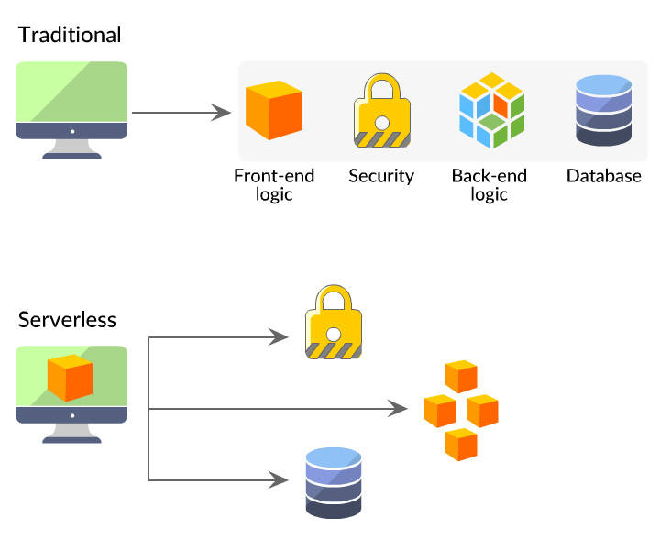
Serverless
source: https://danielhkim.net/2020/02/27/serverless-cloud-computing/

Slide 5
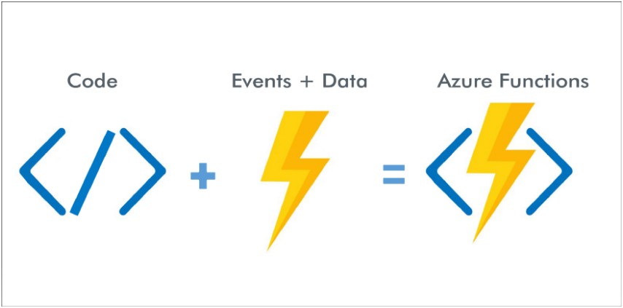
Azure Functions

Slide 6
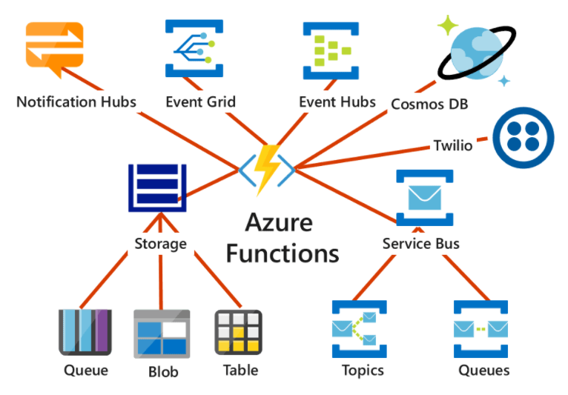
Azure Functions

Slide 7
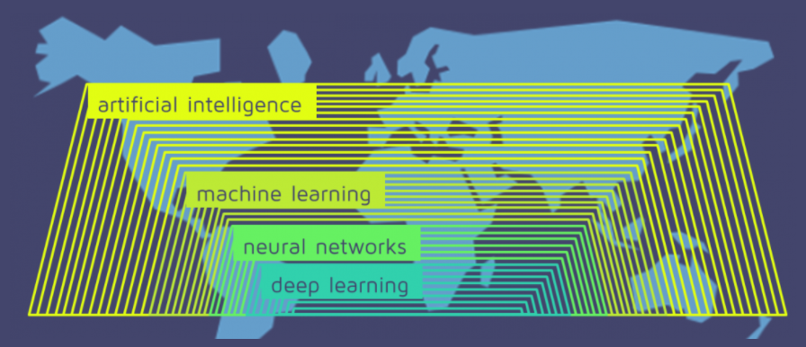
Deep Neural Network
source: https://quantdare.com/what-is-the-difference-between-deep-learning-and-machine-learning/
Notes:
AI involves a computer executing a task a human could do.
Machine learning involves the computer learning from its experience and making decisions based on the information.

Slide 8
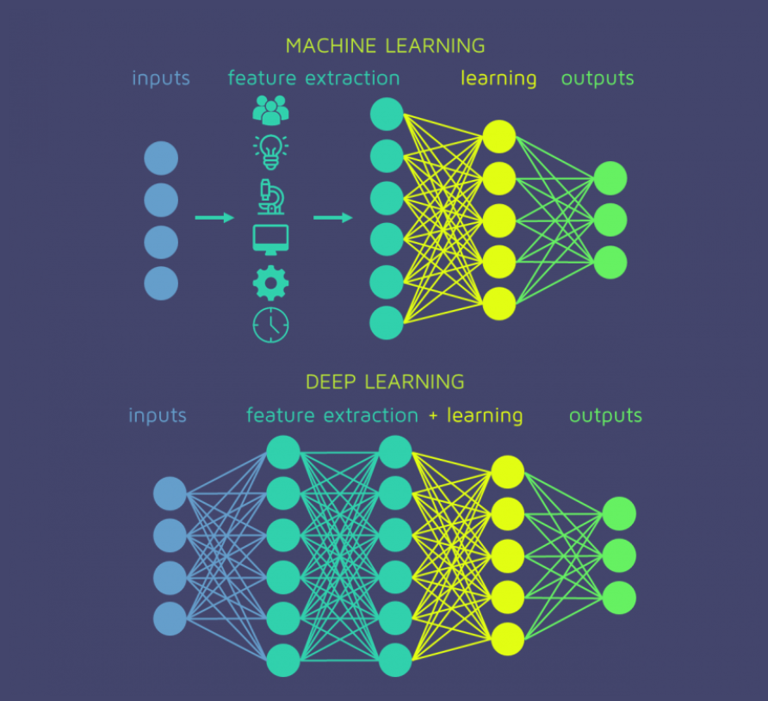
Deep Neural Network
source: https://quantdare.com/what-is-the-difference-between-deep-learning-and-machine-learning/

Slide 9
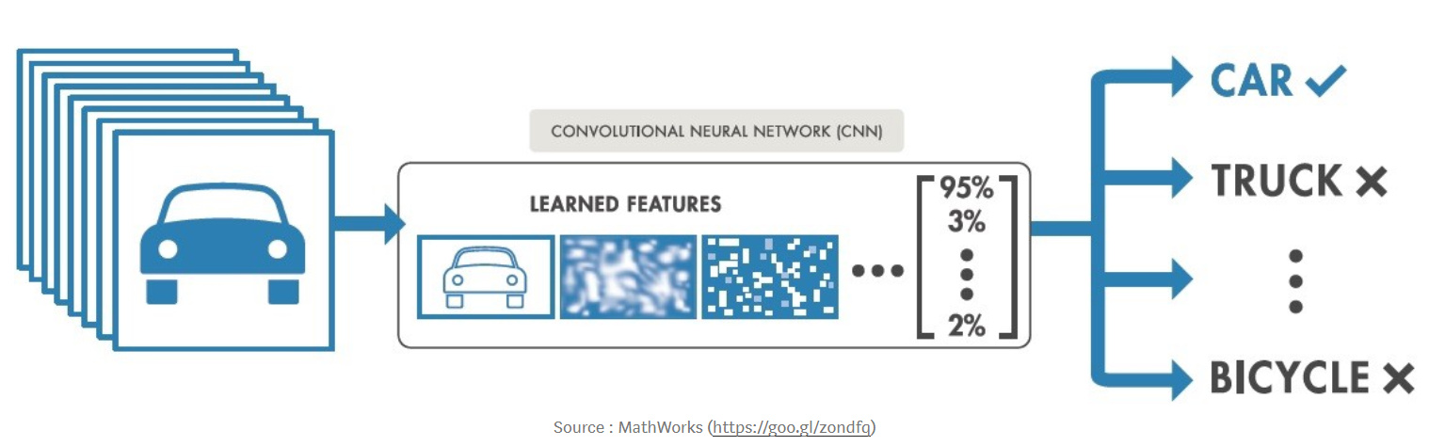
Image Classification

Slide 10
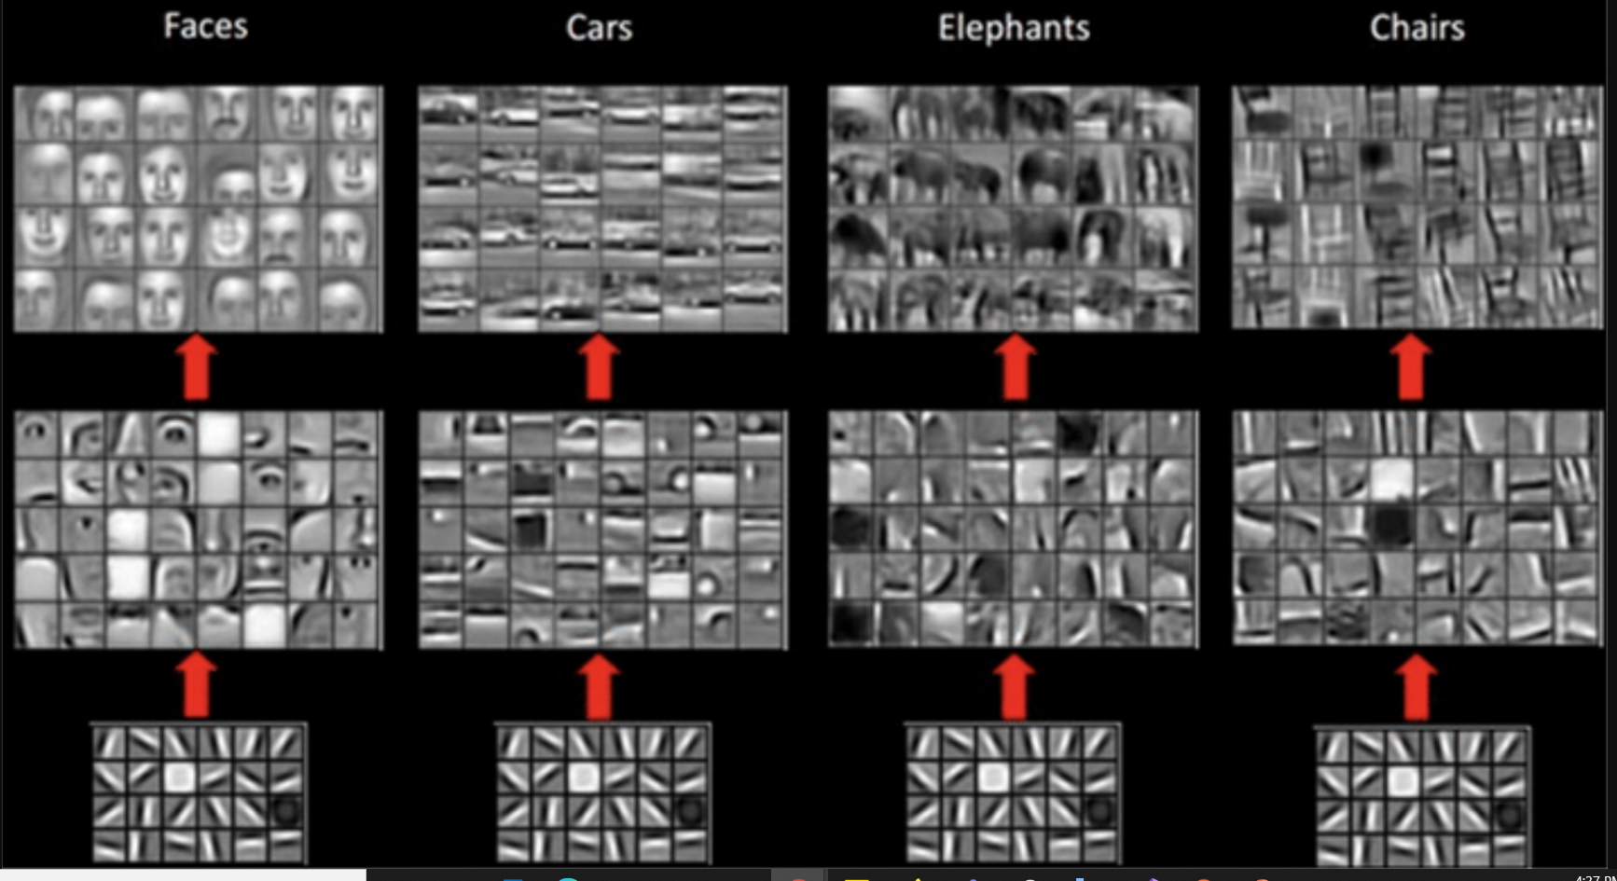
Image Classification
source: https://miro.medium.com/max/1910/1*fLGuAUT5imTIGAeA4zzaWA.png

Slide 11
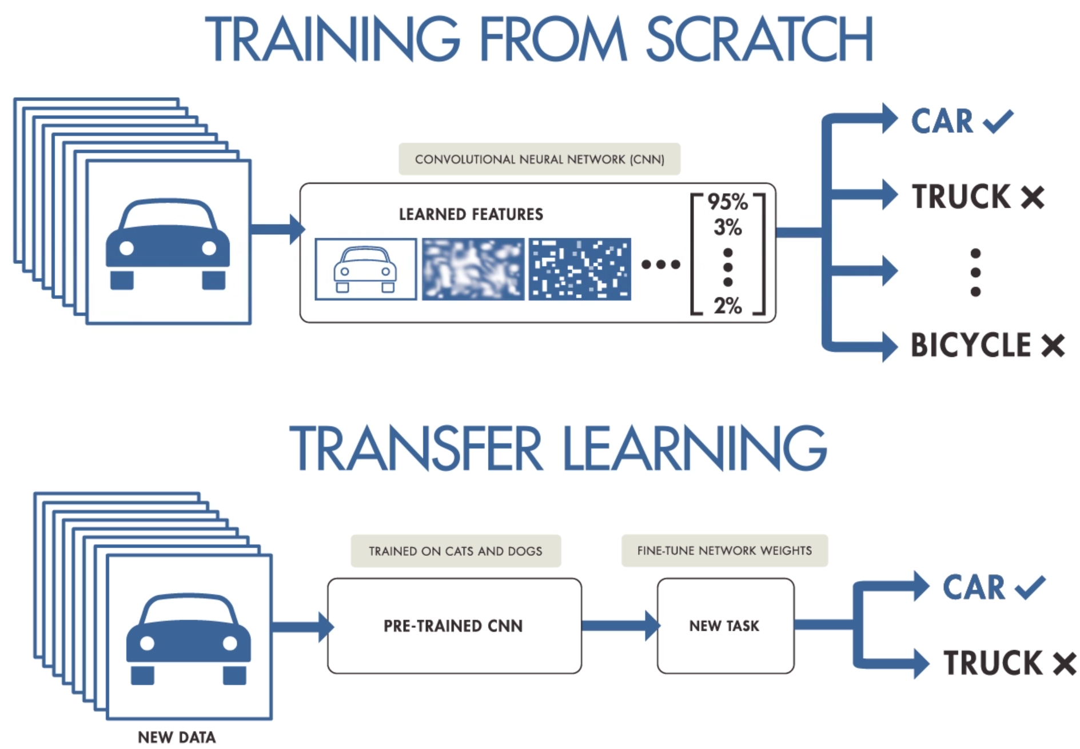
Transfer Learning – MobileNet V2
source: https://i.pinimg.com/originals/0a/76/eb/0a76eb3c95c249cdff9449af08ac4efc.png

Slide 12
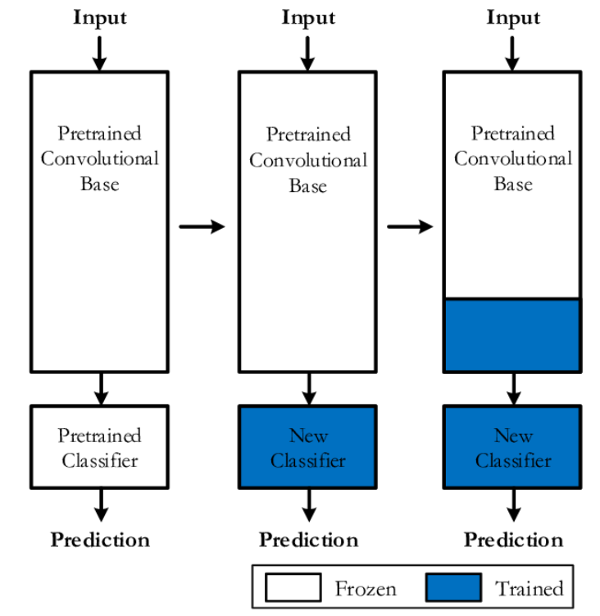
Transfer Learning
source: https://www.researchgate.net/figure/TOP-LEVEL-DIAGRAM-OF-TRANSFER-LEARNING-FROM-A-PRE-TRAINED-CNN-MODEL_fig4_333882146

Slide 13
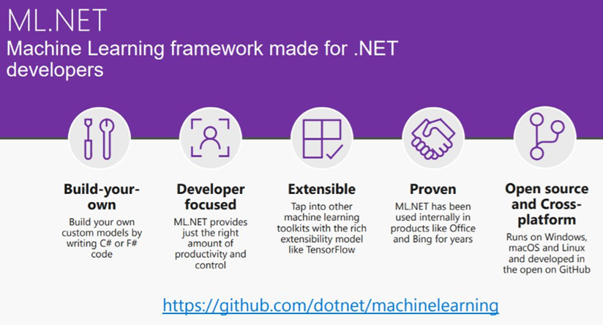
ML.Net

Slide 14
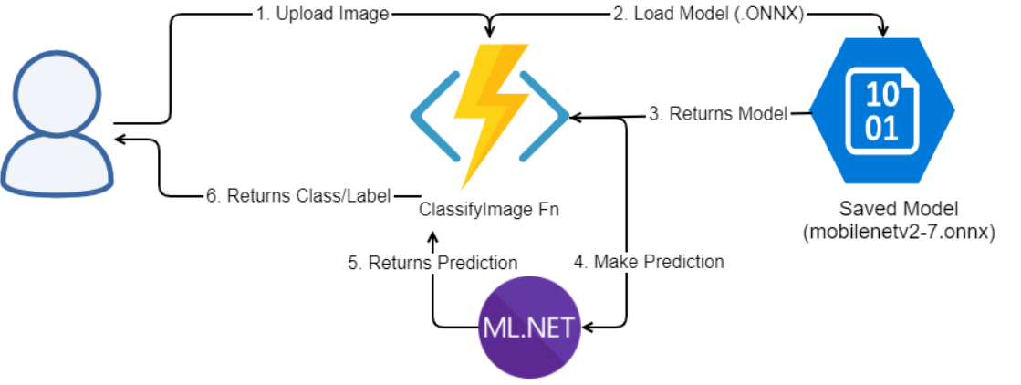
Cloud Architecture

Slide 15
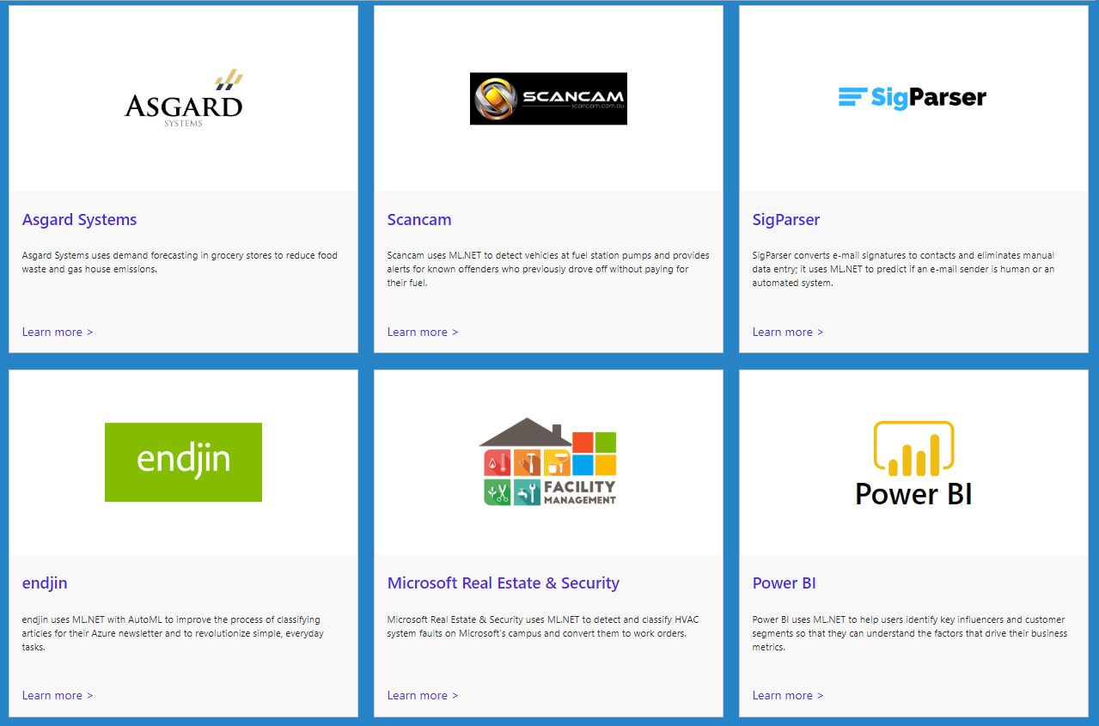
Customer Success Stories – ML.Net
https://dotnet.microsoft.com/apps/machinelearning-ai/ml-dotnet/customers

Slide 16
Demo

Slide 17
Resources
Github: https://github.com/praveenraghuvanshi/tech-sessions/tree/master/27102021-AI-Dev-World-2021

Slide 18
References
https://docs.microsoft.com/en-us/azure/azure-functions/functions-develop-vs
https://blog.rasmustc.com/multipart-data-with-azure-functions-httptriggers/
https://docs.microsoft.com/en-us/dotnet/machine-learning/tutorials/image-classification
https://docs.microsoft.com/en-us/samples/dotnet/machinelearning-samples/mlnet-image-classification-transfer-learning/
https://docs.microsoft.com/en-us/dotnet/machine-learning/tutorials/object-detection-onnx

Slide 19





Thank you Q & A
https://in.linkedin.com/in/praveenraghuvanshi
https://github.com/praveenraghuvanshi
@praveenraghuvan
https://t.me/joinchat/IifUJQ_PuYT757Turx-nLg

